Slide 1
CLI 2016 Budget Survey Results
Finance Committee

Slide 2
What it took to make do this survey
Finance Committee asked for approval from CDD Board
Board Approved Surveying the Community by postal and email
Finance Committee planned survey and mailing method
Finance Committee Secretary negotiated for advertising rates to save mailing costs
Staff assisted in mailing and email
Finance Committee Secretary reproduced 2016 Proposed Budget in 188 page Survey Monkey
8 hrs!
Analyzed results
Prepared presentation

Slide 3
Purpose of the Survey
To let the CDD Board Members know that answer to the question:
What Do Residents Want?

Slide 4
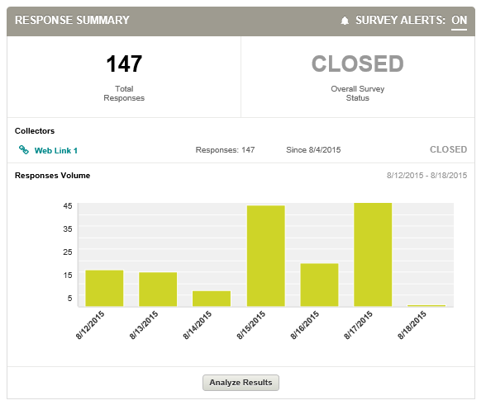
Outcome of the survey
143 responses out of 950 residences (15%)
Many text comments to be assessed in more detail
All anonymous results to be published online for public review
Results were assessed for Statistical Significance

Slide 5
Overall Operations Budget
$ 239,615 - Professional & Administrative
$ 242,118 - Utilities
$ 247,680 - Security Operations
$ 291,447 - Field Office Administration
$ 473,000 - Landscape Maintenance
$ 201,500 - Facilities Maintenance
$ 54,515 - Pool Maintenance

Slide 6
Budget Category Results (n=143, 15% MOE)
Amount | Category | Yes, Approved | No, See More | Spread: In Favor
$ 239,615 | Professional & Administrative | 54.5% | 45.5% | +9%
$ 242,118 | Utilities | 58.5% | 41.5% | +17%
$ 247,680 | Security Operations | 60.0% | 40.0% | +20%
$ 291,447 | Field Office Administration | 38.9% | 61.1% | -22%
$ 473,000 | Landscape Maintenance | 77.6% | 22.4% | +55%
$ 201,500 | Facilities Maintenance | 82.8% | 17.2% | +66%
$ 54,515 | Pool Maintenance | 80.7% | 19.3% | +61%

Slide 7
Amount | Category | Yes, Approved | No, See More | Spread: In Favor
$ 75,000 | Field manager | 74.6% | 25.4% | +49.2%
$ 46,852 | Office administrator | 70.2% | 29.8% | +40.4%
$ 12,960 | Payroll taxes | 93.0% | 7.0% | +86.0%
$ 17,000 | Seasonal decorations | 57.9% | 42.1% | +15.8%
$ 4,075 | Beach club office equipment | 70.2% | 29.8% | +40.4%
$ 3,000 | Beach club office supplies | 73.7% | 26.3% | +47.4%
$ 1,500 | Beach club gym supplies | 82.5% | 17.5% | +65.0%
$ 1,000 | Guard office equipment | 86.0% | 14.0% | +72.0%
$ 2,000 | Guard office supplies | 80.7% | 19.3% | +61.4%
$ 1,068 | CMMS license & support | 87.7% | 12.3% | +75.4%
$ 49,992 | Community events coordinator | 28.1% | 71.9% | -43.8%
$ 30,000 | Community events supplies | 29.8% | 70.2% | -40.4%
$ 3,000 | Special residential mailing | 73.7% | 26.3% | +47.4%
$ 44,000 | Pool & beach club attendant | 57.9% | 42.1% | +15.8%
$ 0 | Food service plans | 87.7% | 12.3% | +75.4%
Field Office Admin Results (n=57, 25% MOE)

Slide 8
Capital Expenses
Original List of Capital Improvements created by LAF Committee
Submitted to CDD Board for approval
CDD opted to include the list into a survey to get resident opinions
A few additional items were added based on previous resident surveys for the gym
If less than $51,800 in capital expenses is spent then assessments will decrease.
If more than $51,800 is spent then a special assessment must be done for the difference.

Slide 9
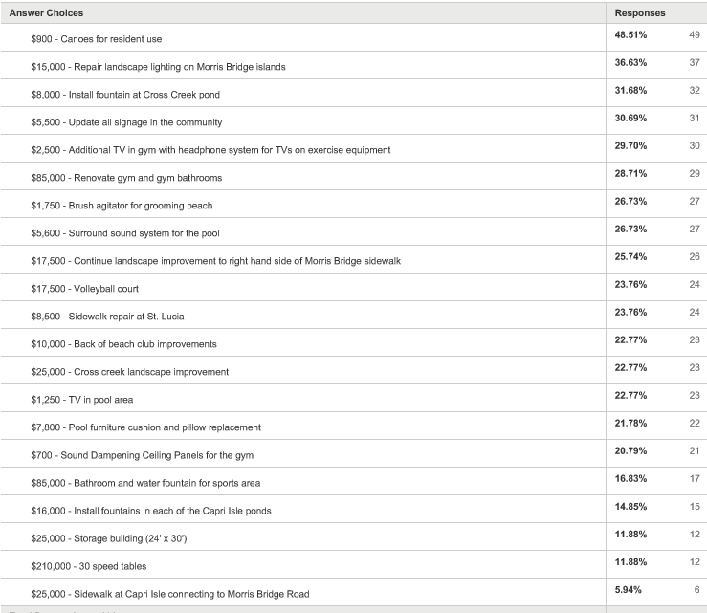
Capital Expenses Results

Slide 10
Amount of expenses selected by individuals

Slide 11
Conclusion
The majority of the respondents, most often with statistical significance, indicate that they are ok with the proposed Budget with the exception of limited specific line items.
There is convincing evidence that the community as a whole would like the CDD Board to cut out or significantly reduce the events coordinator and expenses.
50% of the respondents requested that capital expenses are below $51,800 and the other half are above. While the average request is $90,000.
If the board reduces the events expenses, the following options are available:
  Reduce the assessment below $1,925.
  Add operational cost.
  Make additional capital purchases.
  Add to the reserves.

